Slide 1

Principal Component Analysis (PCA): How to Use for Feature Selection
Principal Component Analysis (PCA) is a powerful statistical technique widely used for dimensionality reduction and feature selection. This technique transforms a dataset with potentially correlated variables into a set of linearly uncorrelated variables called principal components.

Slide 2

Agenda
1
Introduction to PCA
Understanding what PCA is and why it's valuable in data analysis and machine learning workflows.
2
Mathematical Foundations
Exploring the underlying mathematics that make PCA work, including covariance matrices, eigenvalues, and eigenvectors.
3
Implementation Procedure
Step-by-step breakdown of how to implement PCA, from data preprocessing to interpreting results.
4
Feature Selection Applications
Practical approaches to using PCA specifically for feature selection, with examples and best practices.

Slide 3

What is Principal Component Analysis?
Principal Component Analysis (PCA) is a dimensionality reduction technique that transforms the original features into a new set of uncorrelated variables called principal components. These components are ordered by the amount of variance they explain in the data.
PCA finds the directions (principal components) along which the variation in the data is maximal. By projecting the data onto these components, we can reduce dimensionality while retaining most of the important information.
At its core, PCA helps us understand the internal structure of the data in a way that best explains the variance in the data. This makes it incredibly valuable for feature selection, data visualization, and preprocessing for machine learning models.

Slide 4

Why PCA Matters in Data Analysis
Dimensionality Reduction
Feature Selection
Reduces the number of features while preserving as much information as possible, making analysis more computationally efficient and avoiding the curse of dimensionality.
Helps identify which combinations of features contain the most information, enabling more effective model training with fewer variables.
Noise Reduction
Data Visualization
By focusing on components with highest variance, PCA can filter out noise in the data, resulting in cleaner signals for analysis.
Enables visualization of high-dimensional data by projecting it into 2D or 3D space, making patterns and clusters more apparent to the human eye.

Slide 5




The Curse of Dimensionality
Sparsity Problem
Computational Complexity
Overfitting Risk
As dimensions increase, data becomes increasingly sparse. The available data points become insufficient to find reliable patterns, leading to poor model performance.
With too many features relative to observations, models tend to overfit training data, capturing noise rather than actual patterns and performing poorly on new data.
Higher dimensions exponentially increase computational requirements. Algorithms that work well in low dimensions may become prohibitively expensive as dimensions grow.
PCA directly addresses these challenges by reducing the dimensionality of data while preserving most of the information, making subsequent analyses more robust and efficient.

Slide 6
How PCA Works: The Big Picture
Original Data
1
Start with a dataset containing potentially correlated features in high-dimensional space.
2
Standardization
Standardize the data so that features with larger scales don't dominate the analysis.
Covariance Matrix
3
Calculate the covariance matrix to understand relationships between features.
4
Eigenvectors
Find eigenvectors and eigenvalues of the covariance matrix, which will become our principal components.
Feature Projection
5
Project the original data onto the principal components to obtain the reduced-dimensional representation.

Slide 7




Mathematical Foundation: Covariance Matrix
Data Matrix X
Begin with data matrix X of size n×p (n observations, p features). Standardize this matrix so each feature has mean 0 and standard deviation 1.
Covariance Calculation
1
2
The covariance between two features is calculated as: cov(Xi, Xj) = Σ(Xik - μi)(Xjk - μj)/n
Covariance Matrix
Properties
4
3
The covariance matrix C is a p×p matrix where each element Cij represents the covariance between features i and j.
The covariance matrix is symmetric and positive semi-definite, meaning all eigenvalues are non-negative.

Slide 8

Mathematical Foundation: Eigendecomposition
Find Eigenvalues
Solve the characteristic equation |C - λI| = 0 to find the eigenvalues λ1, λ2, ..., λp of the covariance matrix.
Find Eigenvectors
For each eigenvalue λi, find the corresponding eigenvector vi that satisfies Cvi = λivi.
Sort by Eigenvalues
Sort eigenvalues in descending order λ1 ≥ λ2 ≥ ... ≥ λp and rearrange eigenvectors accordingly.
Form Principal Components
The eigenvectors become the principal components, with the first eigenvector (corresponding to largest eigenvalue) being the first principal component.

Slide 9




Step-by-Step PCA Procedure: Part 1
Data Preparation
Organize your data into a matrix X where rows represent observations and columns represent features. Handle missing values appropriately, typically by imputation or removal.
Standardization
Standardize the data to have zero mean and unit variance. This ensures that features with larger scales don't dominate the analysis. Formula: Z = (X - μ)/σ for each feature.
Covariance Matrix Computation
Calculate the covariance matrix of the standardized data. This p×p matrix shows how each feature varies with respect to others. Formula: C = (1/n)ZTZ.

Slide 10





Step-by-Step PCA Procedure: Part 2
Eigendecomposition
Compute the eigenvalues and eigenvectors of the covariance matrix. The eigenvalues represent the amount of variance explained by each principal component.
Select Principal Components
Sort eigenvalues in descending order and select the top k eigenvectors based on the desired dimensionality reduction or variance retention threshold.
Project Data
Project the standardized data onto the selected principal components. Formula: Y = ZW, where W is the matrix of selected eigenvectors.
Analyze Results
Interpret the principal components and analyze the transformed data. Evaluate how much variance is explained by the selected components.

Slide 11



Visualizing PCA: Dimensional Reduction
PCA visualization reveals how high-dimensional data can be effectively represented in lower dimensions. The left figure shows the projection from 3D to 2D space. The center image compares original clusters with their PCA representation. The right figure illustrates how PCA rotates the coordinate system to align with directions of maximum variance.

Slide 12





PCA for Feature Selection: Core Concept
Original Features
1
Multiple potentially correlated features
2
Principal Components
Uncorrelated linear combinations of features
3
Feature Importance
Features with high loadings in top PCs
4
Dimensionality Reduction
Select top k components
5
Optimal Feature Subset
Maximal information, minimal dimensionality
When using PCA for feature selection, we're looking for the original features that contribute most significantly to the top principal components. By examining the loading factors (coefficients of each original feature in the principal components), we can identify which original features are most informative and potentially select a subset for downstream analysis.

Slide 13



Methods for Choosing the Number of Principal Components
Scree Plot Analysis
Variance Explained Threshold
Cross-Validation
Look for the "elbow" point in the scree plot where the rate of decrease in eigenvalues slows significantly. This indicates where additional components start contributing less meaningful information.
Select enough components to explain a predetermined percentage of total variance (typically 80-95%). This ensures you retain most of the information while reducing dimensionality.
Use cross-validation to determine the optimal number of components based on downstream task performance. This directly ties feature selection to the predictive or analytical goal.

Slide 14
Approaches to Feature Selection with PCA
1
Loading-Based Selection
Choose original features with highest loadings
2
Variance-Based Selection
Select features contributing most to variance
3
Recursive Feature Elimination
Iteratively remove less important features
4
Hybrid Approaches
Combine PCA with other selection methods
When performing feature selection with PCA, multiple strategies can be employed. Loading-based approaches focus on identifying which original features have the strongest association with the top principal components. Variance-based methods prioritize features that explain the most variation in the data. Recursive techniques systematically eliminate features to find an optimal subset.
The best approach depends on your specific dataset and objectives. A hybrid strategy often yields superior results by leveraging the strengths of multiple methods.

Slide 15
Feature Loading Analysis
Feature
PC1 Loading
PC2 Loading
PC3 Loading
Importance
Age
0.82
0.15
0.05
High
Income
0.76
0.22
0.11
High
Education
0.64
0.35
0.18
Medium
Experience
0.78
0.13
0.07
High
Credit Score
0.25
0.71
0.16
Medium
Debt Ratio
0.19
0.67
0.22
Medium
Savings
0.32
0.73
0.14
Medium
Location
0.11
0.23
0.79
Low
The loading table shows how strongly each original feature contributes to the principal components. Features with high loadings on important principal components are considered most influential. In this example, Age, Income, and Experience have high loadings on PC1, making them strong candidates for inclusion in a reduced feature set.
For feature selection, we typically focus on features with consistently high loadings across the most important principal components, or those with particularly high loadings on a single important component.

Slide 16





PCA-Based Feature Selection: Practical Example
Apply PCA
Original Dataset
2
Transform to principal components
1
Start with high-dimensional data
Analyze Loadings
3
Identify important features
5
Validate Performance
Test on downstream tasks
4
Select Features
Choose optimal subset
Consider a dataset with gene expression measurements across thousands of genes. Traditional feature selection would be challenging given the high dimensionality. By applying PCA, we transform the data and examine which original genes have the highest loadings on the top principal components.
In a real case study with cancer classification data, reducing from 10,000 genes to just 50 genes with the highest PCA loadings maintained 95% of the classification accuracy while dramatically reducing computational requirements and improving model interpretability.

Slide 17
Advantages and Limitations of PCA for Feature Selection
90%
10x
Variance Retention
Computational Speedup
PCA can often retain 90% or more of the original data variance with significantly fewer dimensions.
Machine learning models can run up to 10 times faster with PCA-selected features on large datasets.
0
40%
Correlation Handling
Interpretability Loss
PCA completely removes correlation between features, eliminating redundancy in the data.
Up to 40% of data scientists report challenges in interpreting models built on principal components rather than original features.
While PCA excels at dimensionality reduction and handling correlated features, it transforms the original feature space, which can make interpretation more difficult. Additionally, PCA is sensitive to scaling and focuses on variance rather than class separation, which may not be optimal for all machine learning tasks.

Slide 18
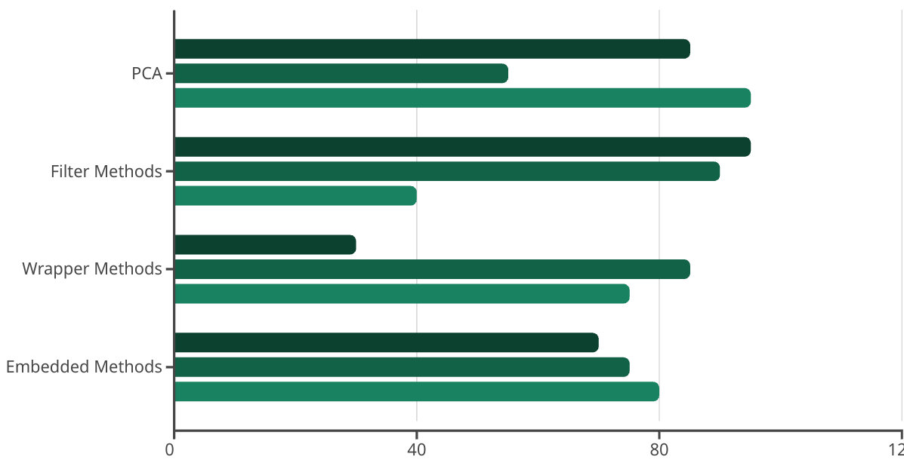
PCA vs. Other Feature Selection Techniques
Speed
Interpretability
Handles Correlation
PCA excels at handling correlated features and offers good computational efficiency compared to other feature selection methods. Filter methods like variance thresholding are faster but don't address feature correlations effectively. Wrapper methods provide high-quality feature subsets but are computationally expensive. Embedded methods like LASSO offer a middle ground.
The ideal approach often involves combining techniques. For example, using PCA to handle correlations followed by a wrapper method on the reduced feature set can leverage the strengths of multiple approaches.

Slide 19
Implementing PCA for Feature Selection: Code Example
# Python implementation of PCA for feature selection import numpy as np import pandas as pd from sklearn.decomposition import PCA from sklearn.preprocessing import StandardScaler # Load and standardize data X = pd.read_csv('data.csv') scaler = StandardScaler() X_scaled = scaler.fit_transform(X) # Apply PCA pca = PCA() pca.fit(X_scaled) X_pca = pca.transform(X_scaled) # Analyze variance explained explained_variance_ratio = pca.explained_variance_ratio_ cumulative_variance = np.cumsum(explained_variance_ratio) # Select optimal number of components n_components = np.argmax(cumulative_variance >= 0.95) + 1 # Get feature importance from loadings feature_importance = np.abs(pca.components_[:n_components]).sum(axis=0) feature_names = X.columns top_features = [feature_names[i] for i in np.argsort(feature_importance)[::-1]] # Select top features selected_features = top_features[:10] # Select top 10 features X_selected = X[selected_features]
This Python code demonstrates a practical implementation of PCA for feature selection. It standardizes the data, applies PCA, examines the cumulative variance to select the optimal number of components, and identifies the most important original features based on their loadings in the principal components.

Slide 20
Key Takeaways and Next Steps
PCA is Powerful but Not Perfect
Choose the Right Implementation
PCA excels at dimensionality reduction and handling correlated features, but consider its limitations regarding interpretability and its focus on variance rather than class separation.
Standardize your data before applying PCA. Select the number of components based on cumulative variance or validation performance. Consider domain knowledge when interpreting the results.
Combine with Other Techniques
Evaluate on Downstream Tasks
For optimal results, consider using PCA in conjunction with other feature selection methods. PCA can be a preprocessing step before applying filter, wrapper, or embedded methods.
Always validate the effectiveness of your feature selection by evaluating performance on the downstream task, whether it's classification, regression, or clustering.
PCA provides a mathematical foundation for reducing dimensionality while preserving information. By understanding both its theoretical underpinnings and practical applications, you can leverage PCA effectively for feature selection across a wide range of data science projects.

